Slide 1

High Level Synthesis in VLSI Design
By: Arsal Abbasi

Slide 2

Contents
Introduction
Toolchains
Analysis
Summary

Slide 3

Introduction
VLSI Design short for Very Large Scale Integration.
VLSI design is a design of a single IC.
VLSI technology allows hundreds of thousands of transistors in one Application-Specific Integrated Circuit (ASIC) [1].
ICs started to become known in the early 1960s.
Different types of intergrations.
Fig. 1 Different ICs

Slide 4
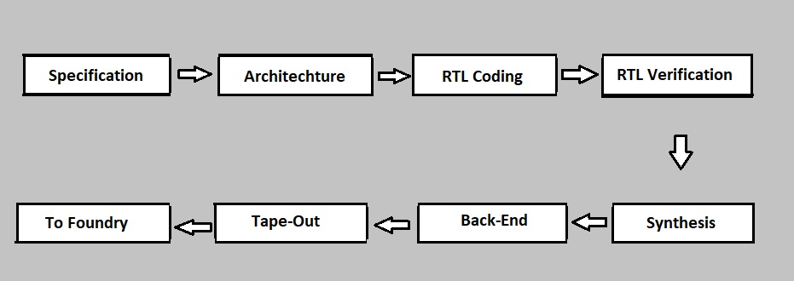
How is VLSI developed?
Includes many steps; Specification, Architecture, RTL Coding, RTL Verification, Synthesis, Back-End, Tape-out, To Foundry.
Fig. 2 Phases in VLSI Designing

Slide 5
Phases
Specification: High level representation of the system.
Architecture: Basic architecture is designed.
RTL Coding: Expressed in HDL.
RTL Verification: Testbench is simulated to verify the correctness.
Synthesis phase: Abstract design is converted to accurately implemented chip.
Back-end phase: Circuit representation is converted to geometric representation.
Tape-out phase: The design is fabricated on tapes.
Foundry phase: All fabricated chips are tested and made ready.

Slide 6
Need for High Level Synthesis
Higher Level of abstraction
Modeling complex design
Reduce design efforts
Fast turnaround time
Technology independence
Ease of HW/SW partitioning

Slide 7
High Level Synthesis
Synthesis step during initial stages of designing.
Defined as the automated desigining process that transforms the behavioral or functional description of the design into a digital hardware implementation [2].
Limitations of HDLs: Difficult to design algorithms, high quality results difficult to achieve, high verification cost and debug time, the design has to be updated.
Provides error-free route from abstract specifications to RTL
Significantly shortens the design time.
Use of C, C++ and SystemC
RTL can be obtained efficiently
Cuts the creation phase by half.
Several tool chains exist.

Slide 8
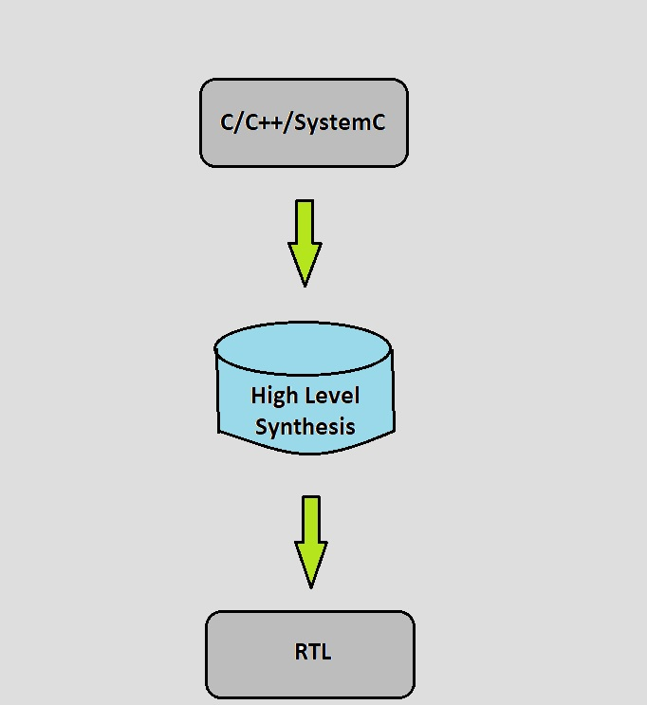
High Level Synthesis
Fig. 3 High Level Synthesis workflow

Slide 9
Toolchains
Xilinx AccelDSP - By Xilinx - Based on DSP technology - Transforms MATLAB floating point design into hardware module [3]. - Carries out automatic HDL code synthesis - Generates three different results; RTL code, Xilinx System Generator and design simulation
Agility Compiler - By Agility Design Solutions - Used to synthesize SystemC - Actel, Altera and Xilinx FPGA are supported for automatic generation - Adds extra hardware features - Designer can explore complex algorithm in the design flow - Designer can reduce overall design time RTL - Use of C++

Slide 10
AutoPilot - By AutoESL - Acquired by Xilinx, Vivado ESL - Number of C based input languages - Generates a wrapper that helps communication between the generated RTL and C testbench - Introduced support for automatically converting OpenCL kernels to IP for Xilinx devices.
BlueSpec - By design company BlueSpec - Design is entered in system Verilog - Implements all design modules as inidividual - Examines the source line by line - Benefits the designer reading and tracing
CatapultC - By Mentor Graphics - Takes ANSI, C, C++ and SystemC as inputs - Generates RTL targeted for ASIC and FPGA - Appreciable user interface - Selection of source file – design setup – design constraints – array mappings - Target Technology and clock rate - Generates testbenches for ModelSim

Slide 11
C-to-Silicon - By Cadence - uses C,C++ and SystemC - bridge the gap between the use of C as a design language and RTL description of the design - Raises design abstraction level - Makes verification more productive - Increases design re-usability - Creates technology library while the design is being built
Synphony C Compiler - By Synopsys - Desigining languages: ANSI C and C++ - Variety of C and C++ constructs are supported - Automated verification occurs at several stages - Generated design, Source code, after pre-processing, scheduling and synthesis

Slide 12
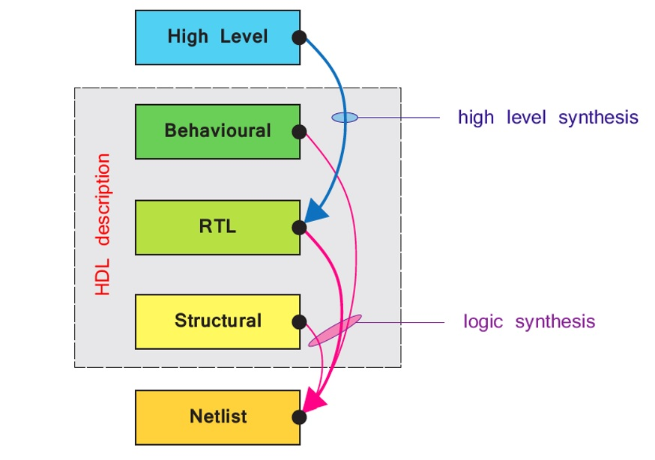
Analysis
High Level Synthesis
Relatively new technology
C/C++ to RTL representation
Room for improvements
Easy verification of the results
Logic Synthesis
Old Technology
RTL to gate level representation
Parameters can be easily manipulated
Easy to model
Source: Zynq Book
Fig. 4 High Level Synthesis vs Logic Synthesis

Slide 13
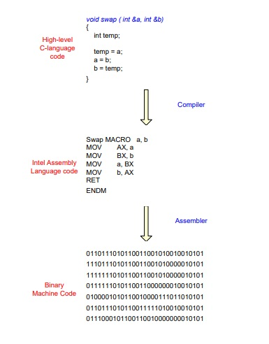
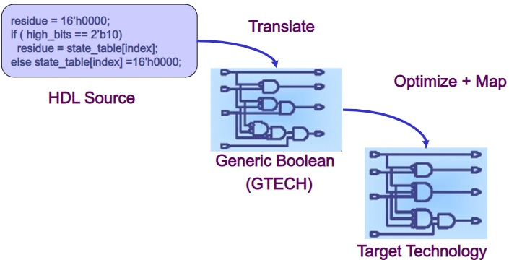
Examples
Fig. 6 Logic Synthesis
Fig. 5 High Level Synthesis

Slide 14
Summary
High-level synthesis means synthesizing the high-level C, C++ or SystemC code into an HDL description.
With a high-level representation, the description of the circuit becomes simpler.
Provides easy verification of the results
Helps designers by reducing design effort and time
Several toolchains exist

Slide 15
Thankyou for your attention!

Slide 16
Sources
[1] R. L. Rudell, Logic Synthesis for VLSI Design. Berkley: University of California, 1989. [2] R.Jain, High Level Synthesis. NA, 2021 [3] Xilinx, AccelDSP Synthesis Tool User Guide, Vol.UG634 (v11.4), www.Xilinx.com

